Slide 1

New York restaurant consumption analysis
New York restaurant location information, business status, customer flow, price and rating correlation analysis

Slide 2
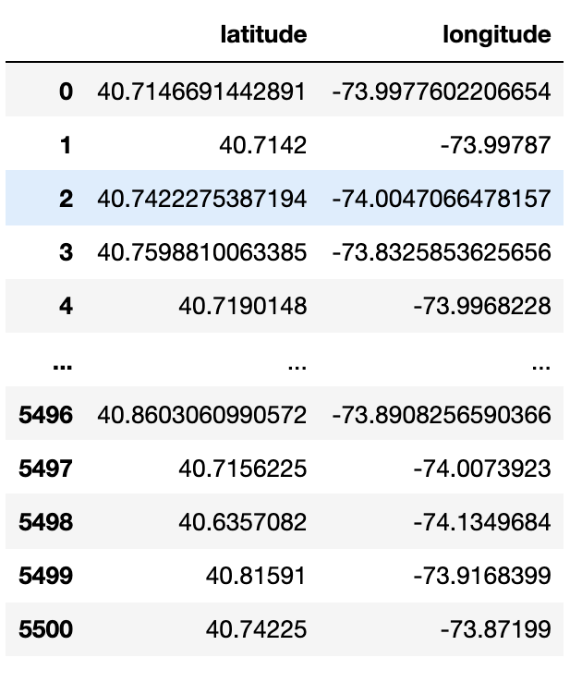
Data acquisition and cleaning
there are other special characters in the latitude and longitude information of the raw data, we need to clean them and readjust them:
categories | coordinates | display_phone | distance | id | image_url | is_closed | location | name | phone | price | rating | review_count | transactions | url | cat
0 | [{'alias': 'shanghainese', 'title': 'Shanghain... | {'latitude': 40.7146691442891, 'longitude': -7... | (212) 233-8888 | 1066.509 | joes-shanghai-new-york-2 | https://s3-media3.fl.yelpcdn.com/bphoto/ekUo5e... | FALSE | {'address1': '9 Pell St', 'address2': '', 'add... | Joe's Shanghai | 1.21E+10 | $$ | 4 | 4696 | [] | https://www.yelp.com/biz/joes-shanghai-new-yor...
1 | [{'alias': 'chinese', 'title': 'Chinese'}, {'a... | {'latitude': 40.7142, 'longitude': -73.99787} | (212) 791-1817 | 1020.196 | tasty-hand-pulled-noodles-new-york | https://s3-media1.fl.yelpcdn.com/bphoto/3_3or7... | FALSE | {'address1': '1 Doyers St', 'address2': '', 'a... | Tasty Hand-Pulled Noodles | 1.21E+10 | $ | 4 | 1280 | ['delivery', 'pickup'] | https://www.yelp.com/biz/tasty-hand-pulled-noo...
2 | [{'alias': 'chinese', 'title': 'Chinese'}, {'a... | {'latitude': 40.7422275387194, 'longitude': -7... | (212) 989-6699 | 4183.124 | buddakan-new-york | https://s3-media4.fl.yelpcdn.com/bphoto/Avw19V... | FALSE | {'address1': '75 9th Ave', 'address2': None, '... | Buddakan | 1.21E+10 | $$$ | 4 | 3278 | ['restaurant_reservation'] | https://www.yelp.com/biz/buddakan-new-york?adj...
3 | [{'alias': 'shanghainese', 'title': 'Shanghain... | {'latitude': 40.7598810063385, 'longitude': -7... | (718) 321-3838 | 14909.39 | nan-xiang-xiao-long-bao-flushing | https://s3-media4.fl.yelpcdn.com/bphoto/ONP2Dh... | FALSE | {'address1': '38-12 Prince St', 'address2': ''... | Nan Xiang Xiao Long Bao | 1.72E+10 | $ | 4 | 2664 | [] | https://www.yelp.com/biz/nan-xiang-xiao-long-b...
Extract latitude and longitude information and generate new columns

Slide 3
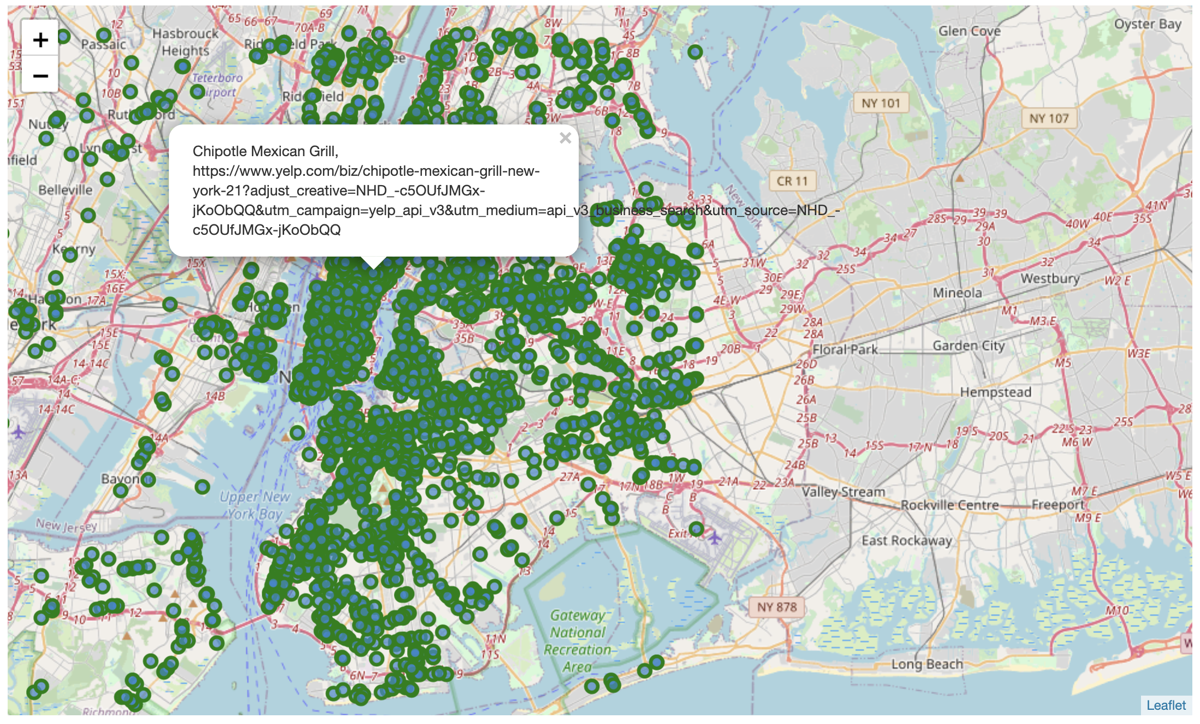
Restaurant distribution: label the restaurant name and URL on the map

Slide 4
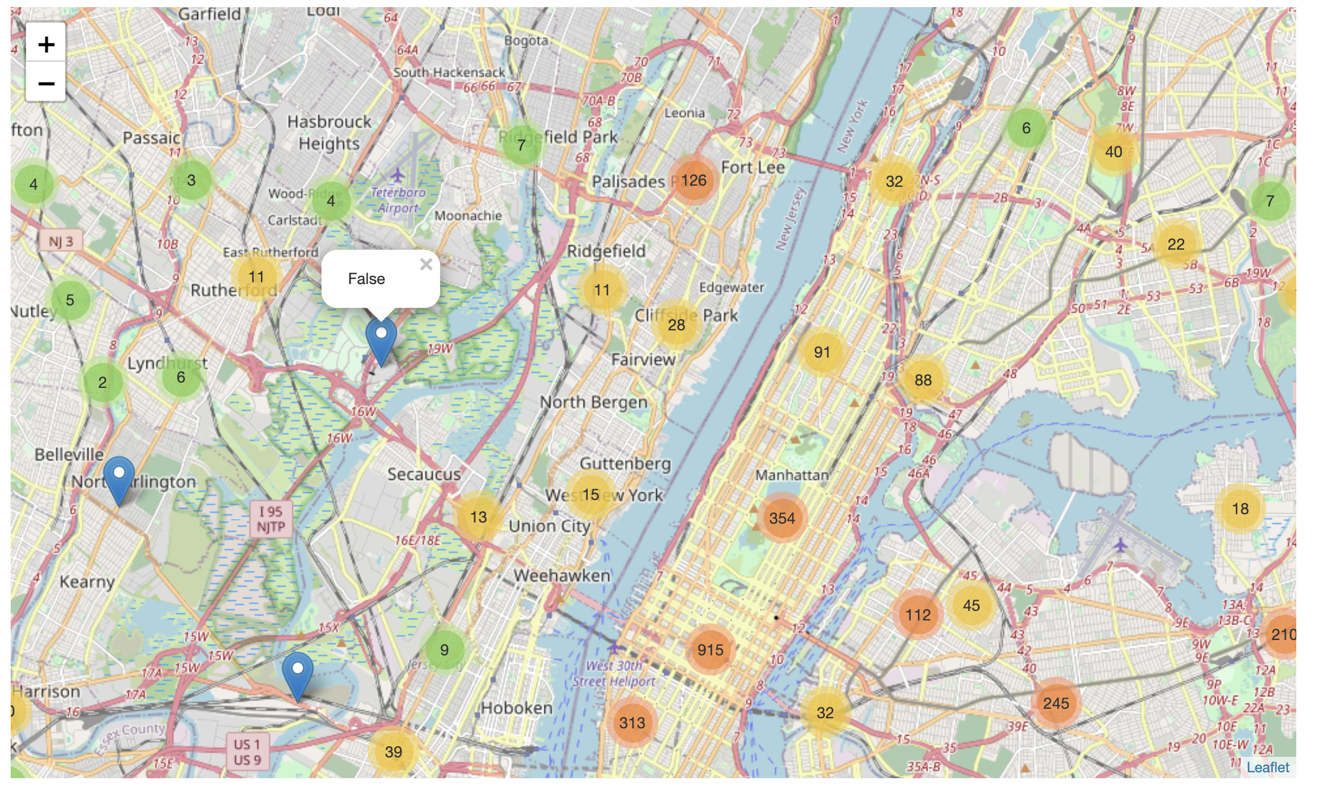
Business status: analyze whether restaurants in different blocks are open

Slide 5
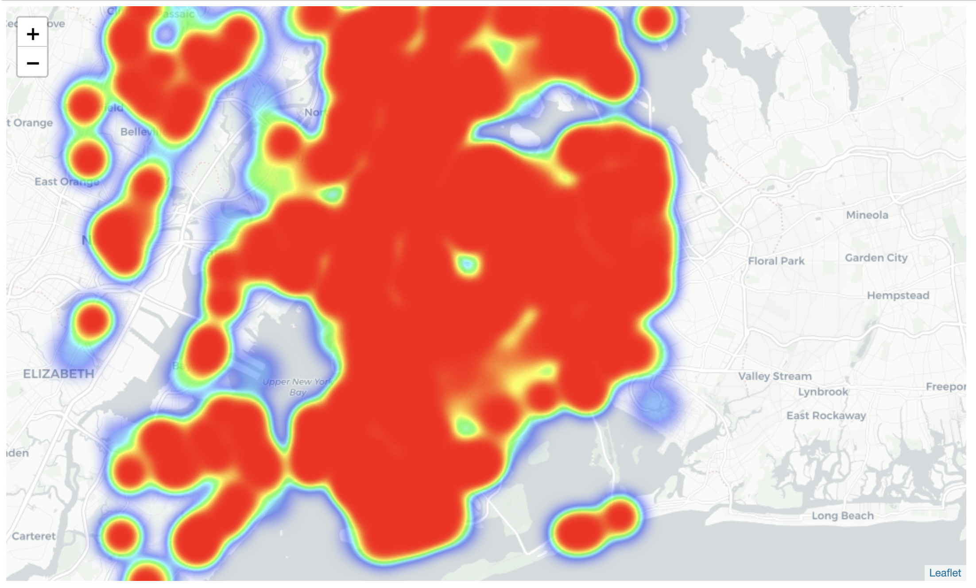
Regional distribution of restaurant popularity: reviews counts heat map

Slide 6
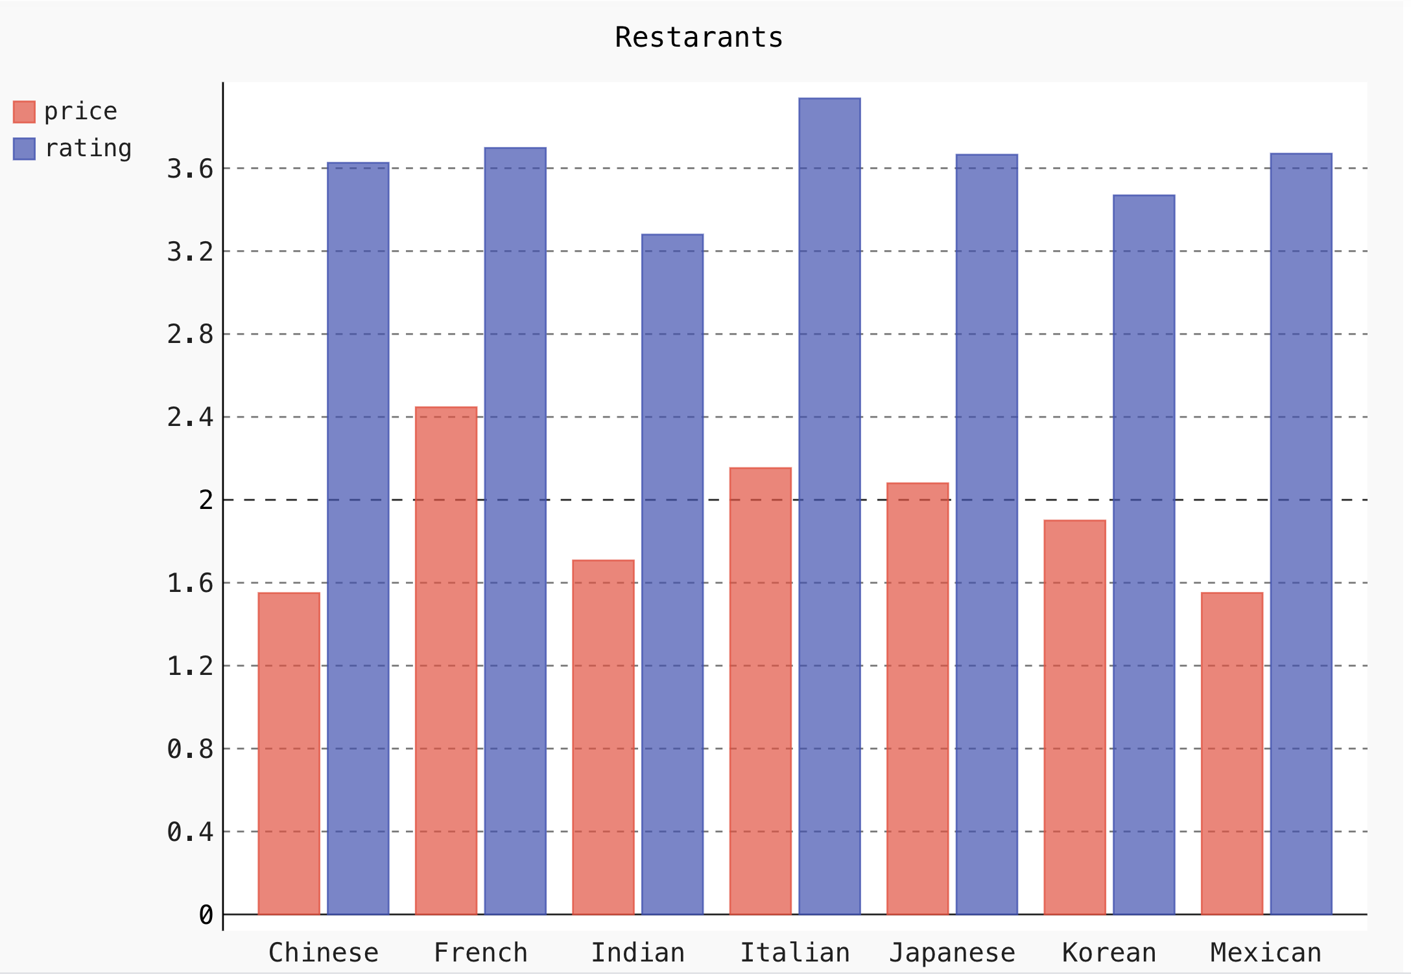
Price and rating: analysis of restaurants with different prices and their rating

Slide 7
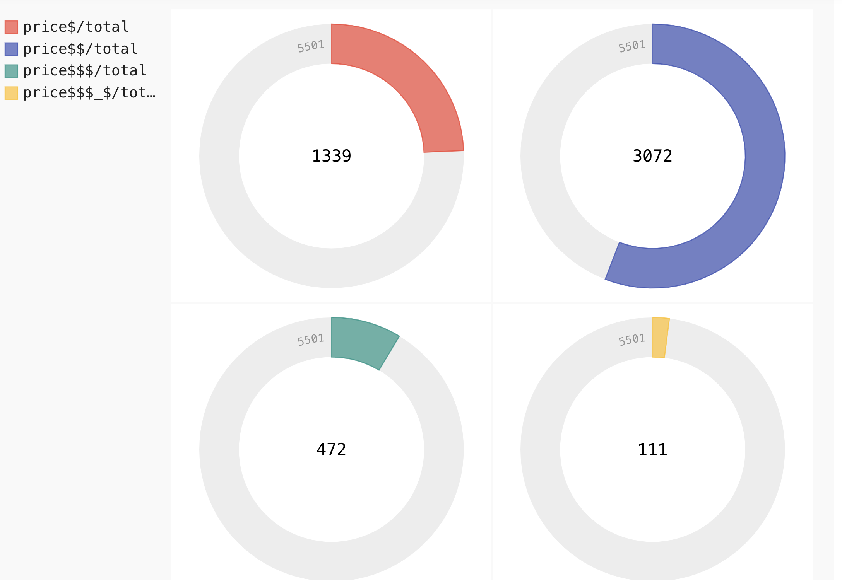
Price and rating: analysis of restaurants with different prices and their rating

Slide 8
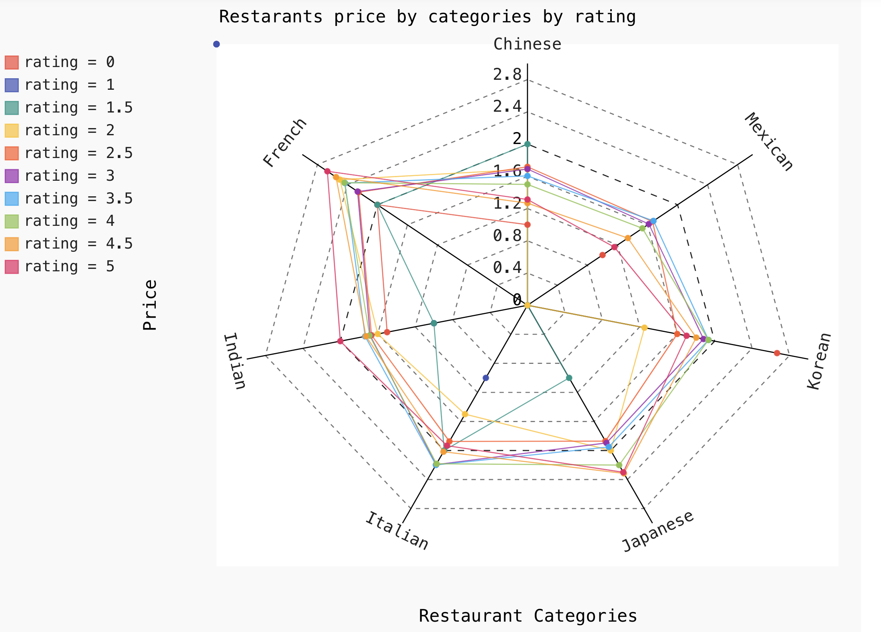
Cuisine Classification Library: Analyze the types and ratings of different types of cuisines
The vertical axis represents price levels. There are 7 directions (sub-axes) equaling to 7 restaurant categories.

Slide 9
Conclusion for the price and cuisines
It means that on average, Chinese restaurants have the lowest prices and French restaurants have the highest prices. The reviews of Indian restaurants are relatively poor, while the reviews of Italian restaurants are relatively high. In addition, there is no obvious relationship between price and rating. In addition, if people want reasonably priced and well-reviewed food, Chinese and Mexican food is recommended.

